Slide 1
Meta Data - EDA
Note: I also included PCA and clustering analysis in my R script, but not the PowerPoint because it was getting fairly long &
I wasn’t sure if we even wanted to look at those.

Slide 2
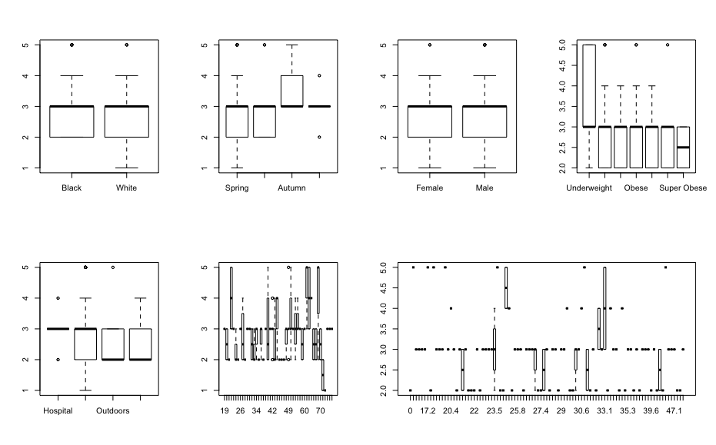
Split by Person - PMI

Slide 3
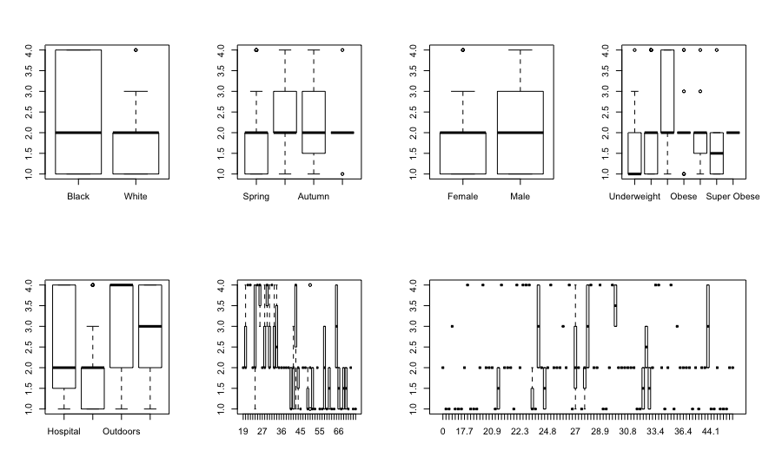
Split by Person - MOD

Slide 4
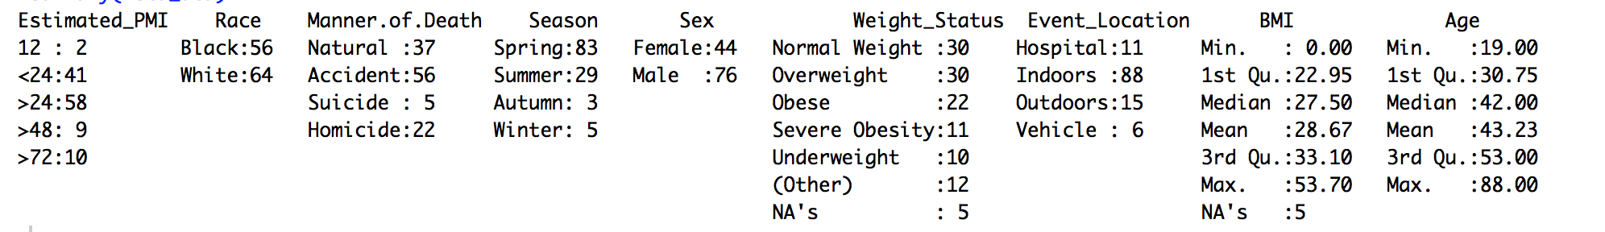
Split by Person - Summary
There does appear to be some variables besides OTU that ought to be included in the model:
- PMI: Season, Weight Status, etc.
- MOD: Pretty much everything

Slide 5
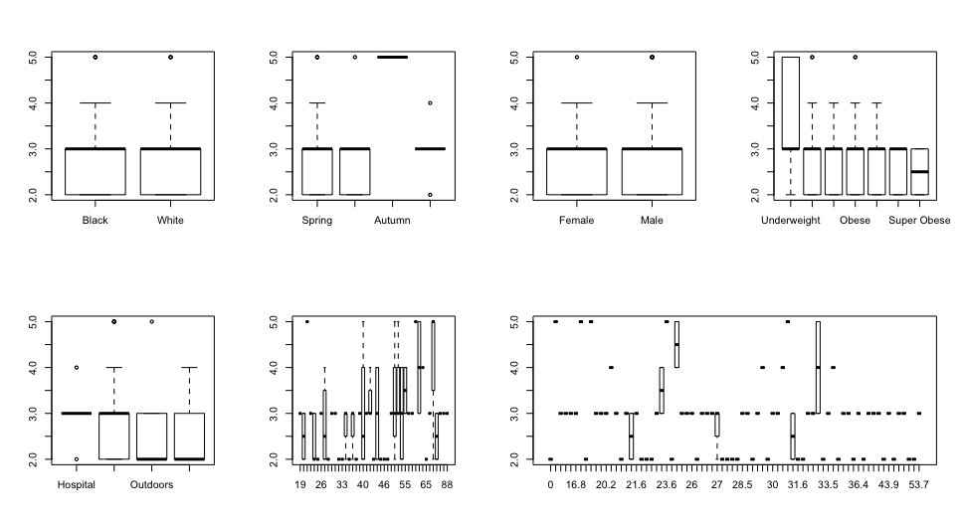
Split by Sample Area – Umbilicus - PMI

Slide 6
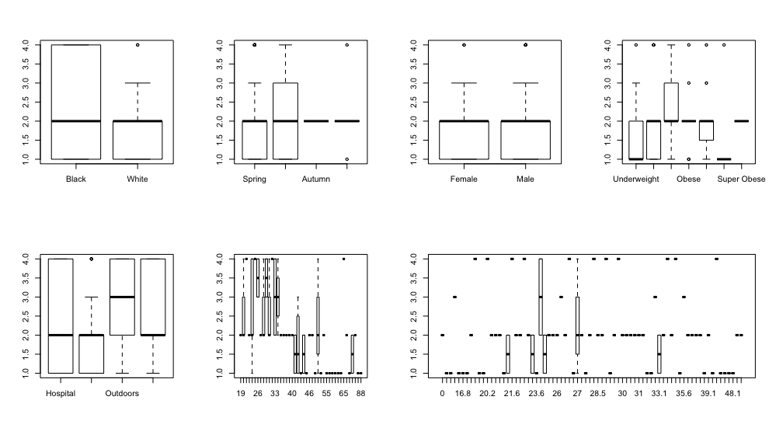
Split by Sample Area – Umbilicus - MOD

Slide 7
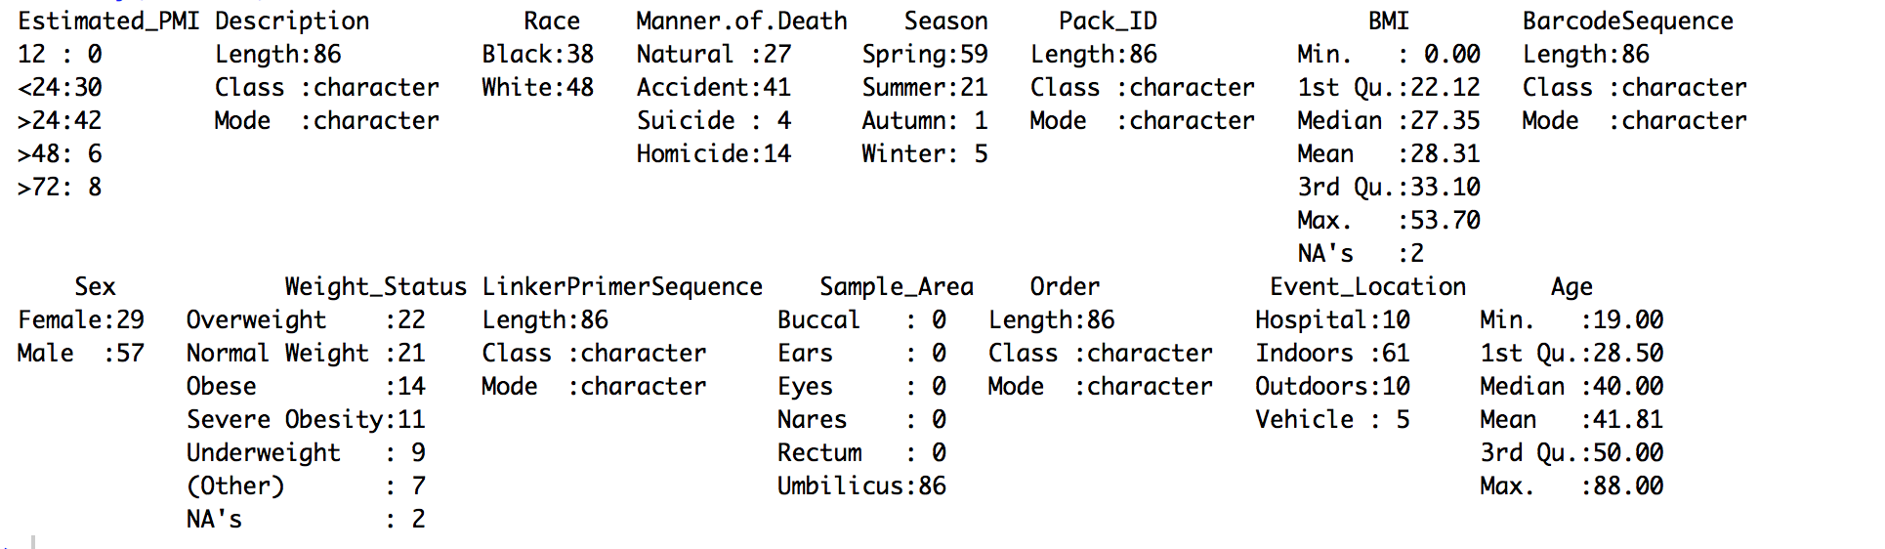
Split by Sample Area – Umbilicus - Summary

Slide 8
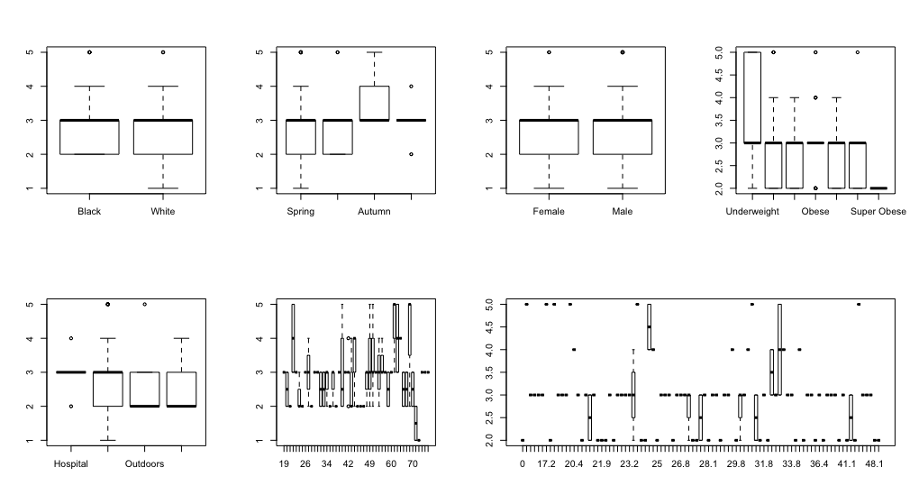
Split by Sample Area – Nares - PMI

Slide 9
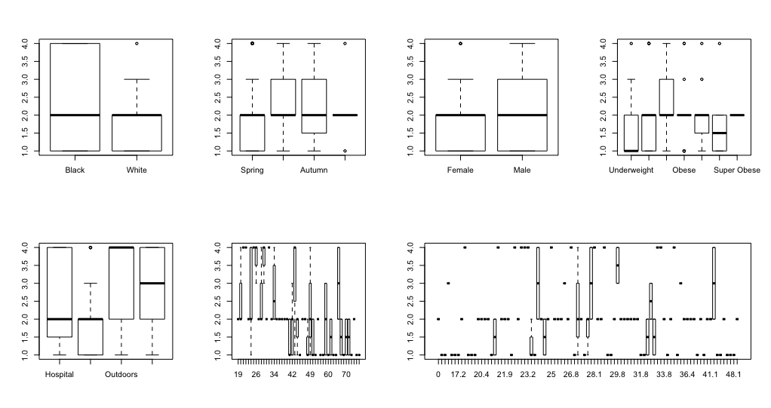
Split by Sample Area – Nares - MOD

Slide 10
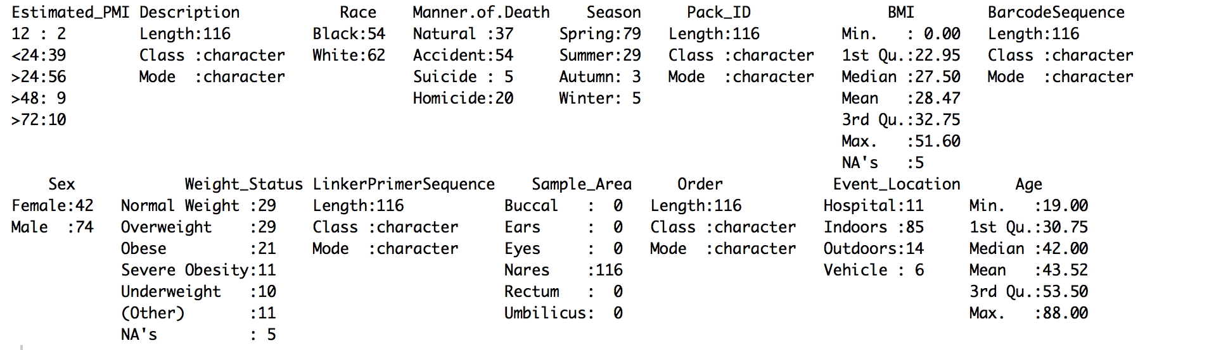
Split by Sample Area – Nares - Summary

Slide 11
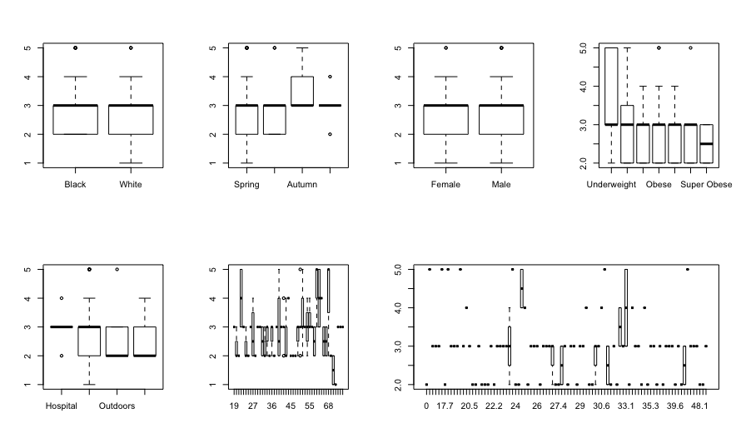
Split by Sample Area – Ears - PMI

Slide 12
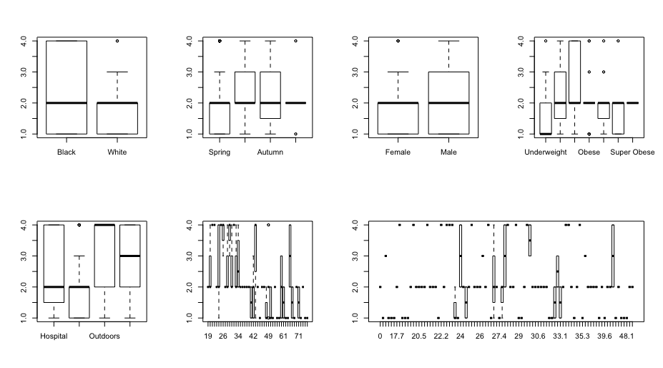
Split by Sample Area – Ears - MOD

Slide 13
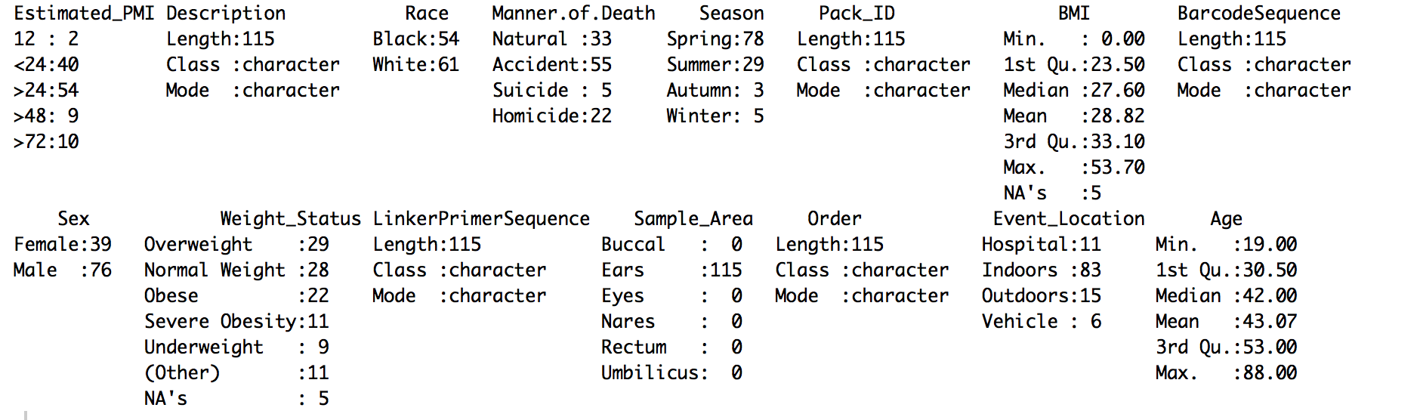
Split by Sample Area – Ears - Summary

Slide 14
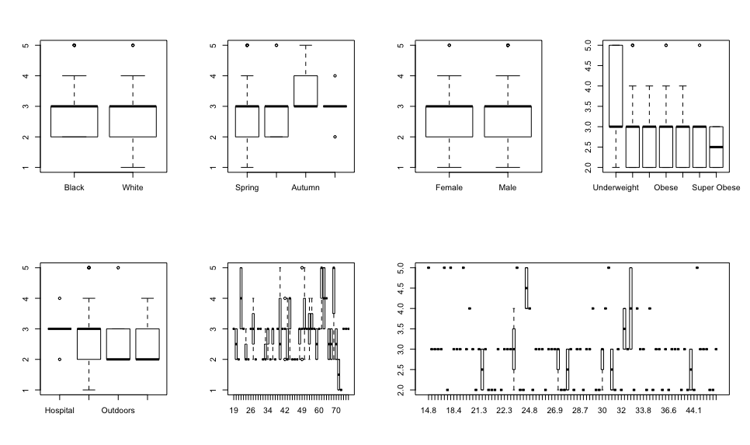
Split by Sample Area – Eyes - PMI

Slide 15

Split by Sample Area – Eyes - MOD

Slide 16
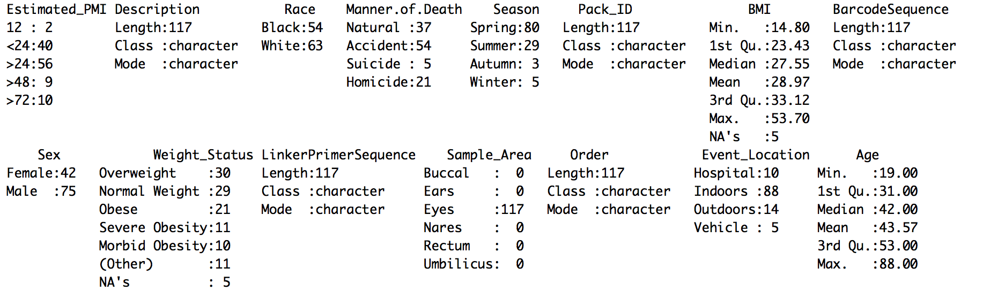
Split by Sample Area – Eyes - Summary

Slide 17
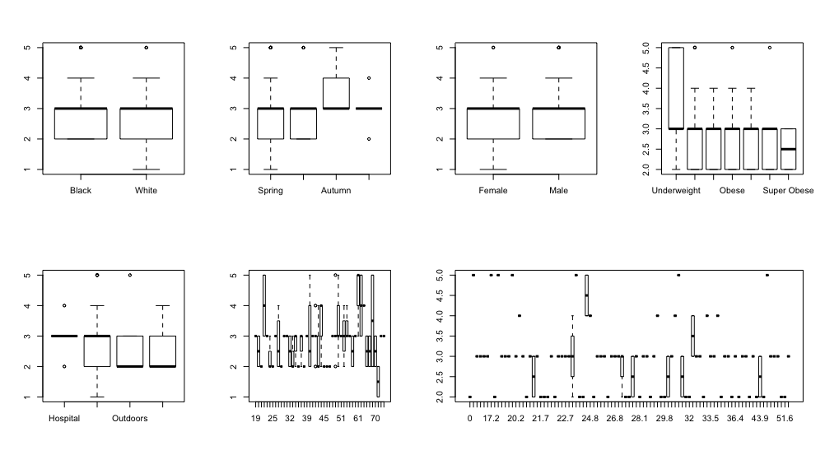
Split by Sample Area – Buccal - PMI

Slide 18

Split by Sample Area – Buccal - MOD

Slide 19

Split by Sample Area – Buccal - Summary

Slide 20
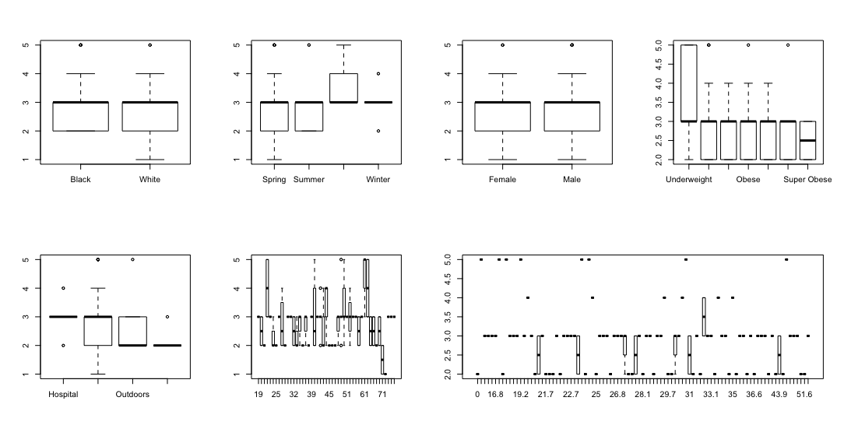
Split by Sample Area – Rectum - PMI

Slide 21

Split by Sample Area – Rectum - MOD

Slide 22
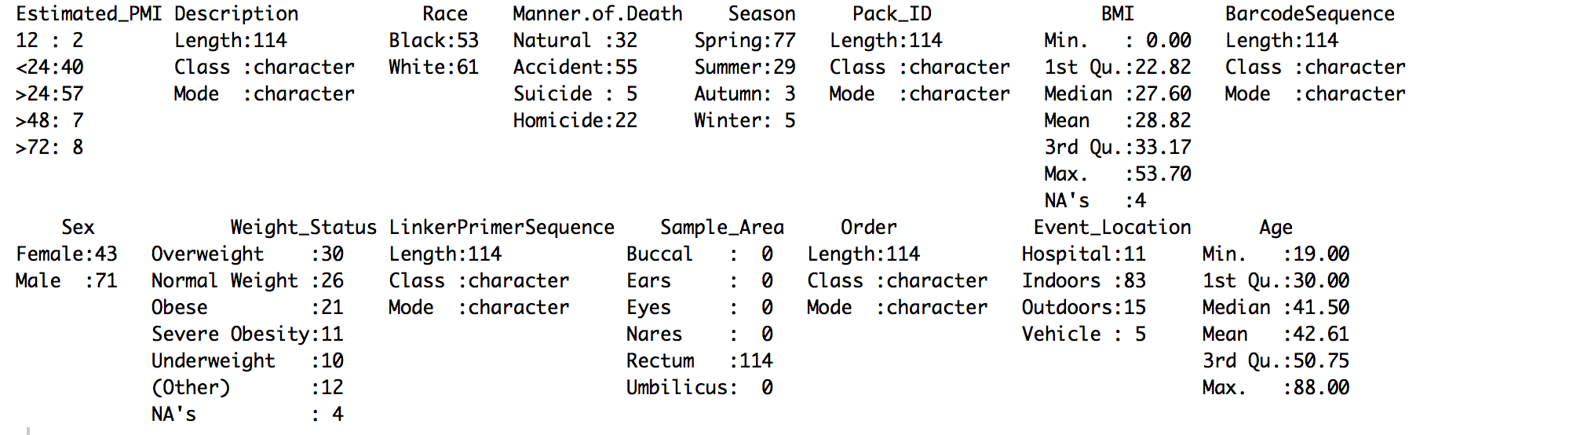
Split by Sample Area – Rectum - Summary

Slide 23
Splitting By Sample Area
Honestly, I’m still not sure how we should handle the sample area issue, i.e. averaging, weighted averages, considering it a factoring, perhaps splitting the data set by sample area as though there were multiple experiments going simultaneously?

